Slide 1
Speech Emotion Recognition
Author: Le Ngoc Hung

Slide 2
Overview
A brief description about the project

Slide 3
Definition
Speech emotion recognition (SER) is the field of technology focused on identifying the emotional state of a speaker from their voice.
Emotions covered: neutral, happy, sad, angry, fear, disgust, and surprise.
(Total: 7 emotions)

Slide 4
How It Works
Speech Input
Pre-processing
Feature Extraction
Emotion Model
Emotion Output

Slide 5

Applications of Speech Emotion Recognition
Mental Health

Slide 6

Applications of Speech Emotion Recognition
Customer Service

Slide 7
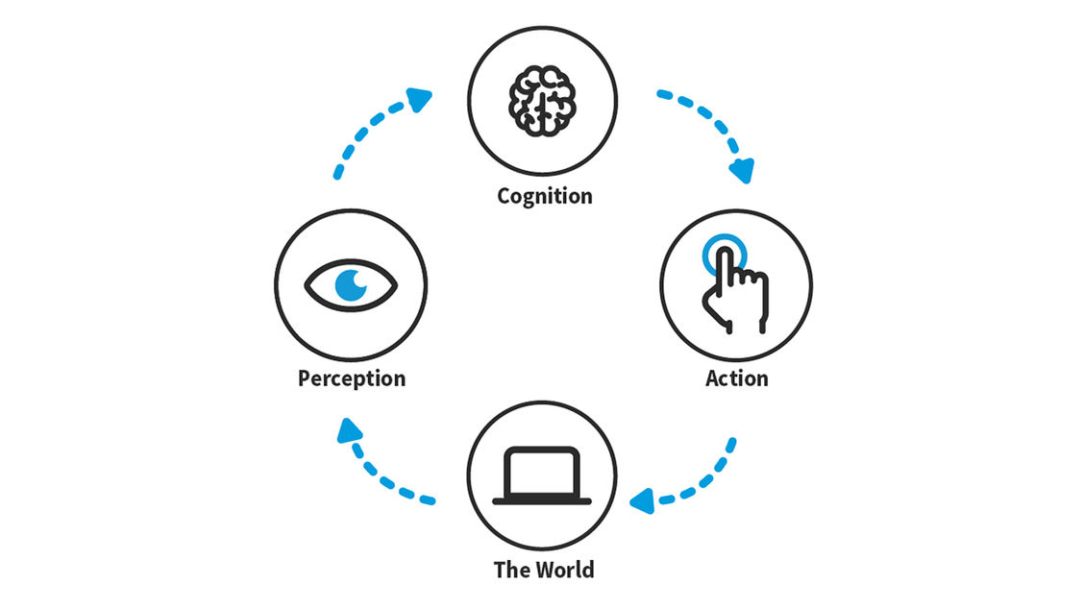
Applications of Speech Emotion Recognition
Human-Computer Interaction

Slide 8

Applications of Speech Emotion Recognition
Market Research

Slide 9

Applications of Speech Emotion Recognition
Game Design

Slide 10
1. Dependencies

Slide 11
Purpose | Library Name
Audio Processing | librosa
Audio Augmentation | audiomentations
Parallel Task Execution | joblib
Data Normalizing Evaluation Report Display | sklearn
Data Processing | numpy panda
Data Visualizing | plotly
Modeling | keras

Slide 12
2. Data Processing

Slide 13
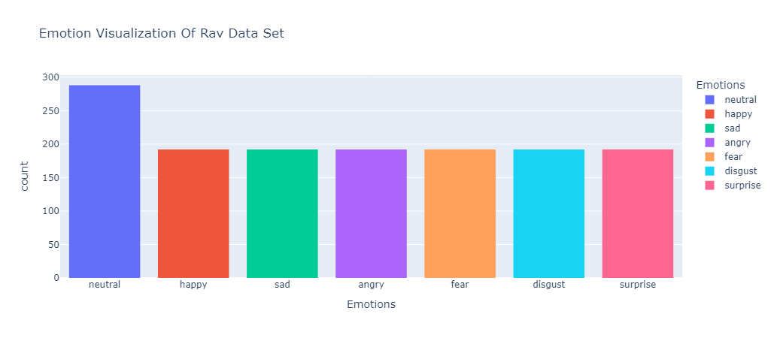
2.1 Ravdess Data Set

Slide 14
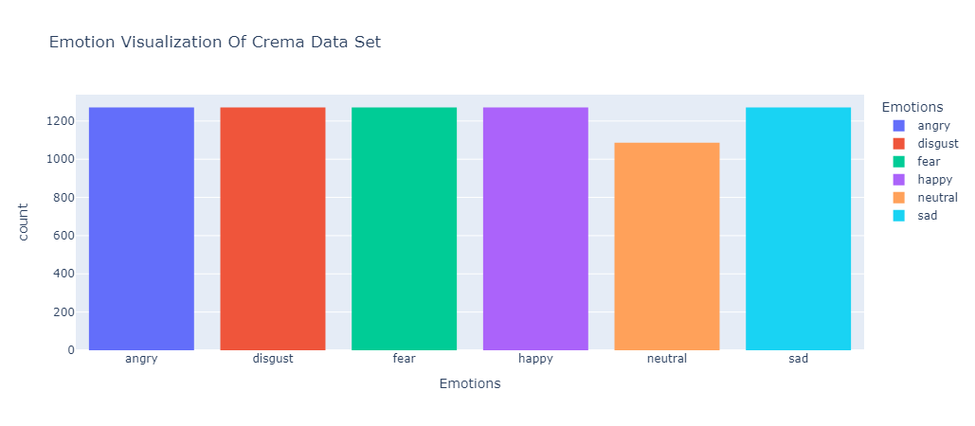
2.2 Crema Data Set

Slide 15
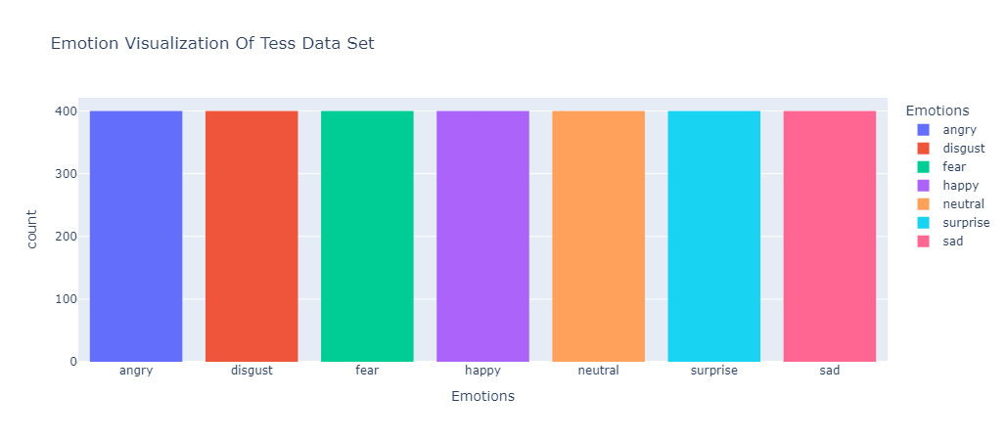
2.3 Tess Data Set

Slide 16
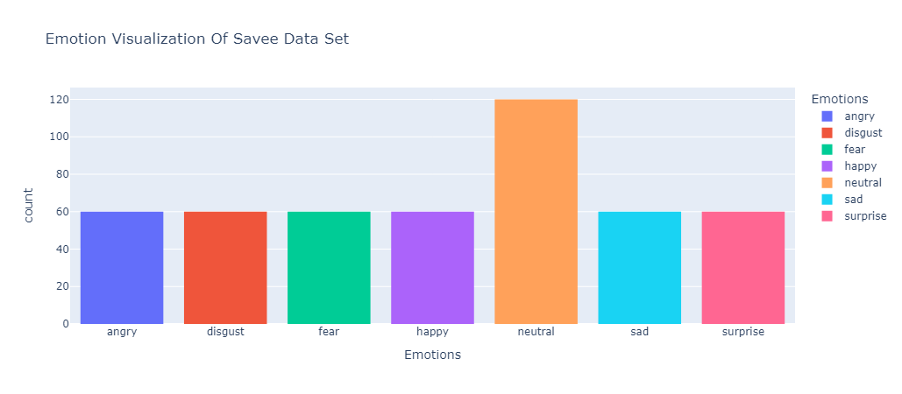
2.4 Savee Data Set

Slide 17
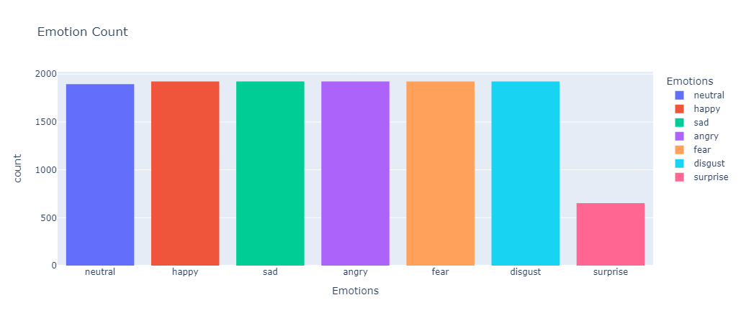
2.5 Combined Data Set (All 4 Combined)

Slide 18
2.5 Combined Data Set (All 4 Combined)

Slide 19
2.5 Combined Data Set (Rav & Tess)

Slide 20
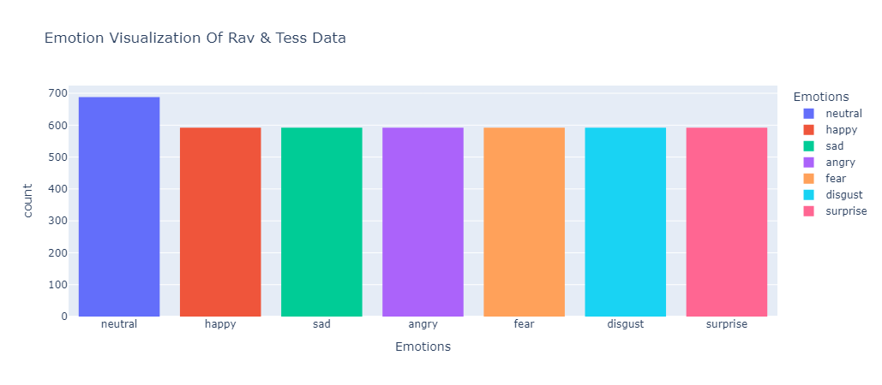
2.6 Combined Data Set (Rav & Tess)

Slide 21
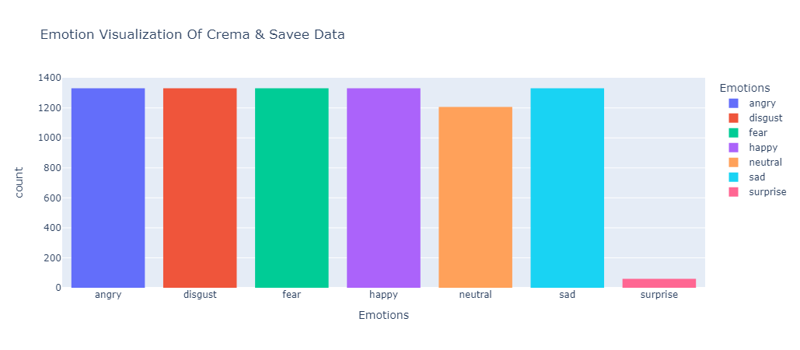
2.7 Combined Data Set (Crema & Savee)

Slide 22
2.6 Data Sets Evaluation
Data Set Name | Emotion Cover | Including Gender Information | Distribution Remark | Language Cover
Ravdess | Full | Yes | “Neutral” and “Calm” are classified as “Neutral” | English
Crema | “Surprise” emotion is not covered | No |  | English
Tess | Full | No |  | English
Savee | Full | No |  | English

Slide 23
3. Audio Augmentation

Slide 24
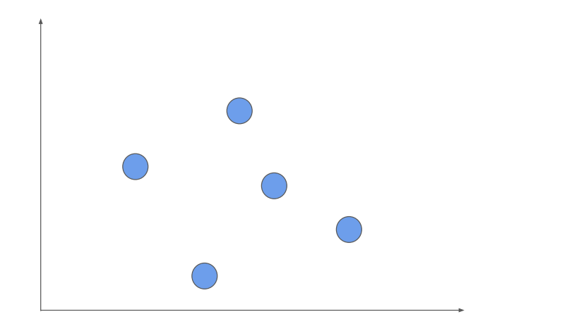
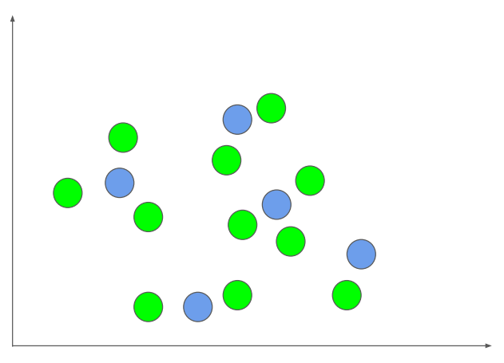
3.1 Purpose
Technique used to increase the number of samples an ML model sees during training
Cover the problem space as much as possible

Slide 25

3.2 Methodology
Transformation 1
Transformation 2
Random select transformation to apply
Random select transformation parameters

Slide 26
Compose
PitchShift
(p=0.5, +- 7 semitones)
TimeStretch
(p=0.5, min=0.8, max=1.25)
TimeMask
(p=0.5, min_band=0.1, max_band=0.15)

Slide 27
4. Features Extraction

Slide 28
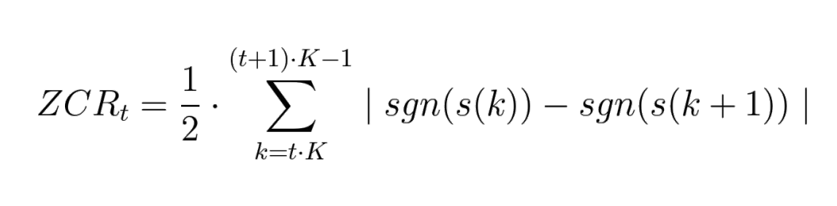
4.1 Time Domain Feature
Zero Crossing Rate:

Slide 29
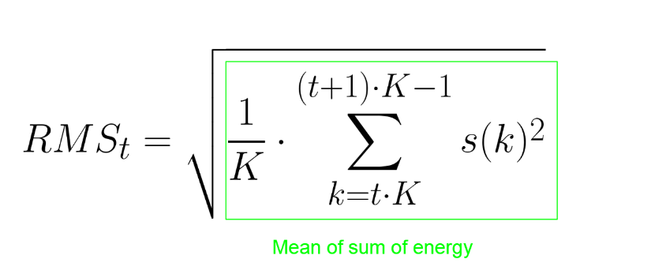
4.1 Time Domain Feature
Root Mean Square (RMS) Value:

Slide 30
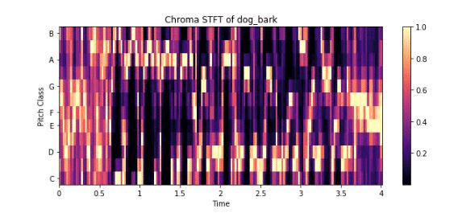
4.2 Frequency Domain Feature
Chroma_STFT

Slide 31
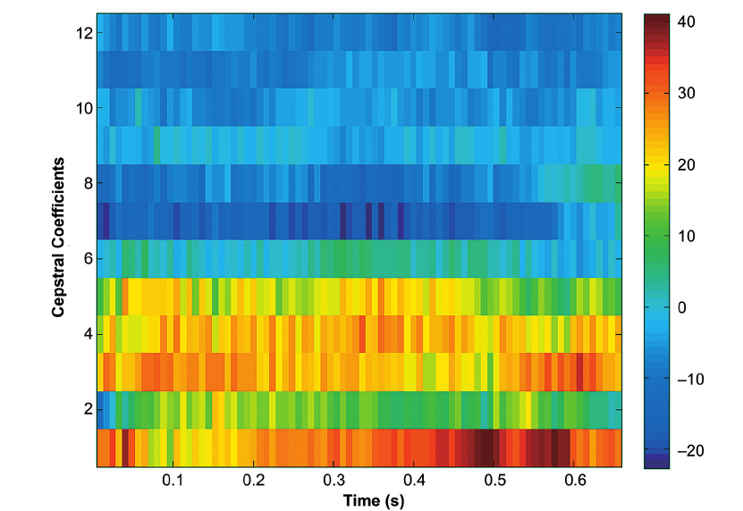
4.2 Frequency Domain Feature
MFCC (Mel-Frequency Cepstral Coefficients)

Slide 32
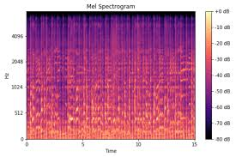
4.2 Frequency Domain Feature
Mel Spectrogram

Slide 33
4.3 Feature Extracting Method
Asynchronous Processing: 1039 secs
Parallel Processing: 250 secs (using Joblib)

Slide 34
5. Modeling

Slide 35
5.1 Model Overview
Conv1D
(NZ=256, K=5, S=1, A=ReLu, P=same)
MaxPooling1D
(PZ=5, S=2,P=same)
Conv1D
(NZ=128, K=5, S=1, A=ReLu, P=same)
MaxPooling1D
(PZ=5, S=2,P=same)
Dropout
(0.2)
Dropout
(0.3)
Dense
(U=16, A=ReLu)
Flatten
MaxPooling1D
(PZ=5, S=2,P=same)
Conv1D
(NZ=32, K=5, S=1, A=ReLu, P=same)
Dense
(U=7, A=SoftMax)

Slide 36
5.2 Model Compile & Training
Property | Value
Optimizer | Adam
Loss | categorical_crossentropy
Metrics | accuracy

Slide 37
5.2 Model Compile & Training
Property | Value
batch_zize | 64
epochs | 50
callbacks | ReduceLROnPlateau

Slide 38
6. Evaluation

Slide 39
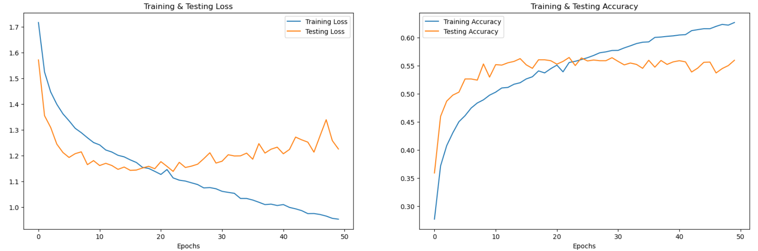
6.1 Model Evaluation Based On 4 Data Set (Crema, Rav, Savee, Tess)
Accuracy of the model on test data: 57.68%

Slide 40
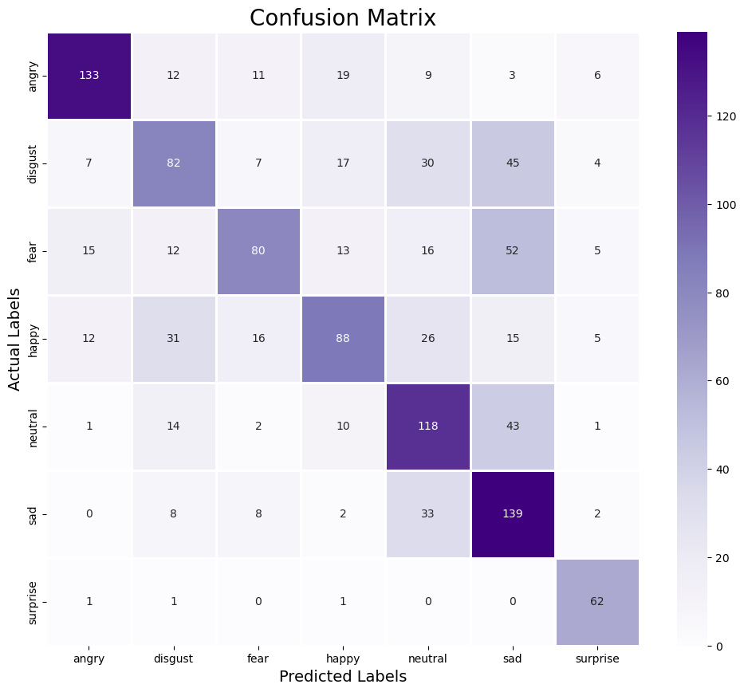
Confusion Matrix

Slide 41
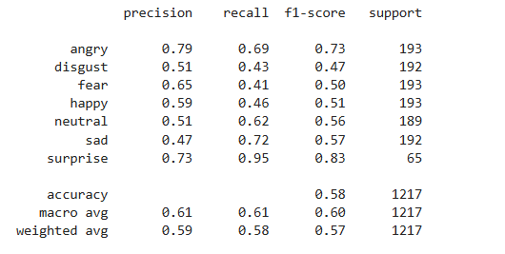
Classification Report

Slide 42
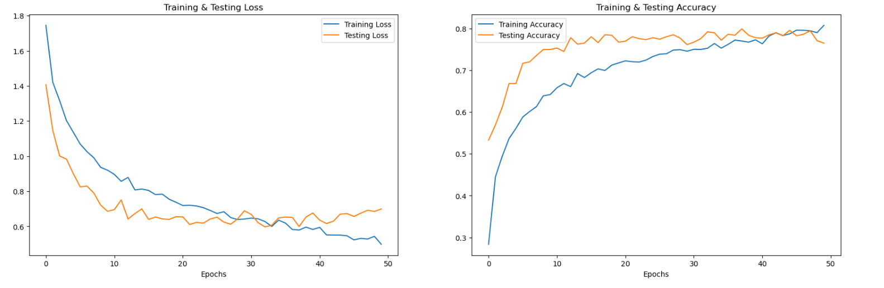
6.2 Evaluate Evaluation Based On 2 Data Sets (Rav & Tess)
Accuracy of the model on test data (Rav & Tess): 80.18%

Slide 43
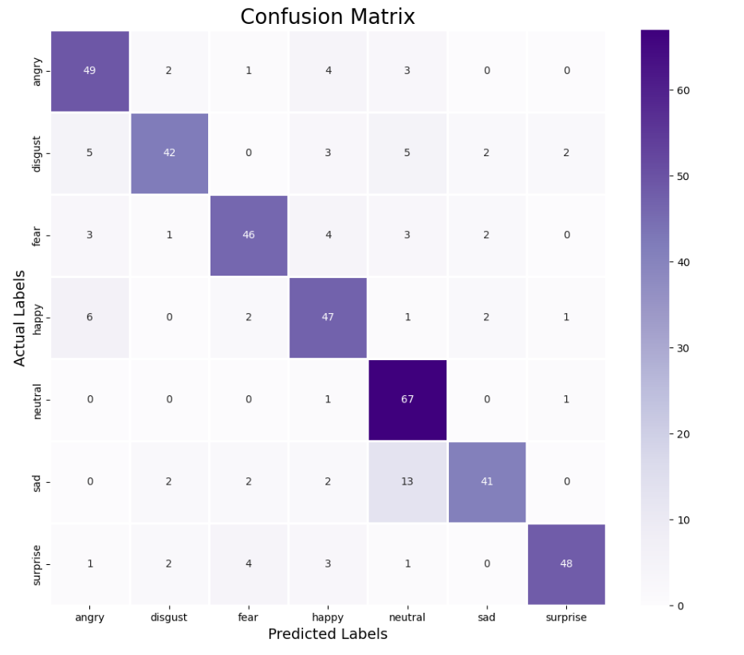

Slide 44
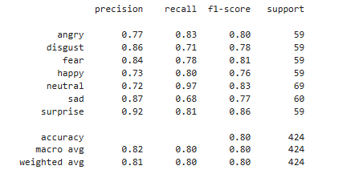
Classification Report

Slide 45

6.2 Evaluate Evaluation Based On 2 Data Sets (Rav & Tess)
Accuracy of the model on test data (Crema & Savee): 90.53%

Slide 46
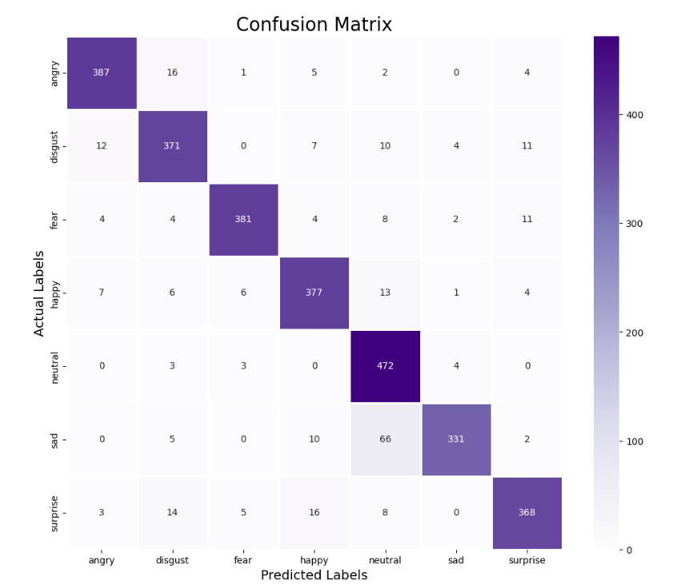
Confusion Matrix

Slide 47
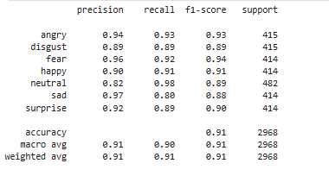
Classification Report

